Slide 1
An Introduction to Sparse Coding, Sparse Sensing, and Optimization
Speaker: Wei-Lun Chao
Date: Nov. 23, 2011
DISP Lab, Graduate Institute of Communication Engineering, National Taiwan University

Slide 2
Outline
Introduction
The fundamental of optimization
The idea of sparsity: coding V.S. sensing
The solution
The importance of dictionary
Applications

Slide 3
Introduction

Slide 4
Introduction
What is sparsity?
Usage:
Compression
Analysis
Representation
Fast / sparse sensing
Projection
bases
Reconstruction bases

Slide 5
Introduction
Why do we use Fourier transform and its modifications for image and acoustic compression?
Differentiability (theoretical)
Intrinsic sparsity (data-dependent)
Human perception (human-centric)
Better bases for compression or representation?
Wavelets
How about data-dependent bases?
How about learning?

Slide 6
Introduction
Optimization
Frequently faced in algorithm design
Used to implement you creative idea
Issue
What kinds of mathematical form and its corresponding optimization algorithms do guarantee the convergence to local or global optima?

Slide 7
The Fundamental of Optimization

Slide 8
A Warming-up Question
How do you solve the following problems?
(1)
(2)
Local minima
Global minima
(a) Plot
5
(b) Take derivatives, check = 0

Slide 9
An Advanced Question
How about the following questions?
(3)
(4)
(5)
(a) Plot? (b) Take derivative = 0?
Derivative?
3
5
How to do?

Slide 10
Illustration
2-D case:

Slide 11
How to Solve?
Thanks to……
Lagrange multiplier
Linear programming, quadratic programming, and recently, convex optimization
Standard form:

Slide 12
Fallacy
A quadratic programming problem with constraints
The importance of each food
Personal nutrient need
Take derivative (x)
(2) Quadratic programming (o)
(3) Sparse coding (o)
Nutrient content of each food

Slide 13
The Idea of Sparsity

Slide 14
What is Sparsity?
Think about a problem?
Assume full rank, N > d
Choose the x with the
least nonzero component
Which do you want?

Slide 15
Why Sparsity?
The more concise, the more better
In some domain, there naturally exists a sparse latent vector that controls the data we saw. (ex. MRI, music)
In some domain, samples from the same class have the sparse property.
The domain can be learned.
A k-sparse domain means that each b can be constructed by a x vector with at most k nonzero element

Slide 16
Sparse Sensing VS. Sparse Coding
Assume that:
Sparse coding
Sparse sensing
Note: p is based on the sparsity of the data (on k)

Slide 17
Sparse Sensing

Slide 18
Sparse Sensing VS. Sparse Coding
Sparse sensing (compressed sensing):
It spends much time or money to get b, so get y first then recover b
Sparse coding (sparse representation):
Believe that there exists the sparse property in the data, otherwise sparse representation means nothing.
x is used to be the feature of b
x can be used to efficiently store b and reconstruct b

Slide 19
The Solution

Slide 20
How to Get The Sparse Solution?
There is no algorithm other than exhaustively searching to solve:
While in some situations (ex. special form of A), the solution of l1 minimization approaches the one of l0 minimization

Slide 21
Why l1?
Question 1: Why l1 can result in a sparse solution?

Slide 22
Why l1?
Question 2: Why the sparse solution achieved by l1 minimization approaches the one of l0 minimization?
This is a matter or Mathematics
No matter how, sparse representation based on l1 minimization has been widely used for pattern recognition.
In addition, if one doesn’t care about using the sparse solution for representation (feature), it seems OK if these two solutions are not the same.

Slide 23
Noise
Sometimes, the data is observed with nose
The answer seems to be negative
possibly not sparse

Slide 24
Noise
Several ways to overcome this:
What is the difference between:

Slide 25
Equivalent form
You may also see several forms for the problem:
These equivalent forms are derived from Lagrange multiplier
There have been several publications aiming at how solving the l1 minimization problem.

Slide 26
The Importance of Dictionary

Slide 27
Dictionary generation
If the preceding sections, we generally assume that the (over-complete) bases A is existed and known
However in practice, we usually need to build it:
Wavelet + Fourier + Haar + ……
Learning based on data
How to learn?
May result in over-fitting

Slide 28
Applications

Slide 29
Back to the problem we have
A quadratic programming problem with constraints
The importance of each food
Personal nutrient need
Take derivative (x)
(2) Quadratic programming (o)
(3) Sparse coding (o)
Nutrient content of each food

Slide 30
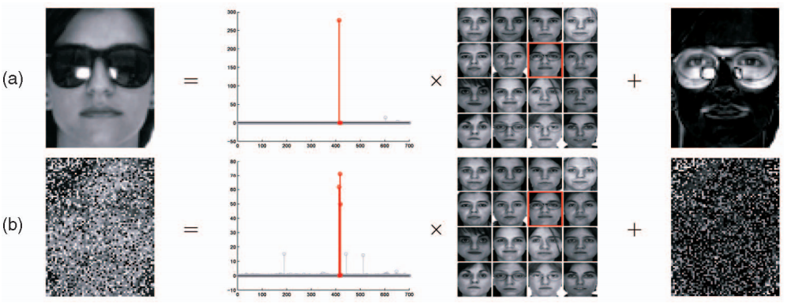
Face Recognition (1)

Slide 31
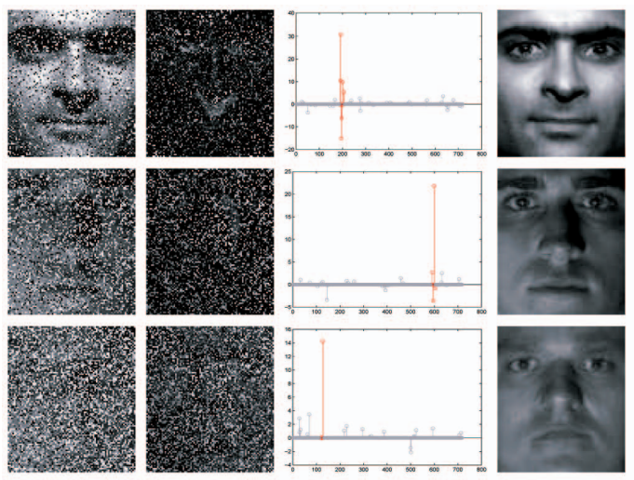
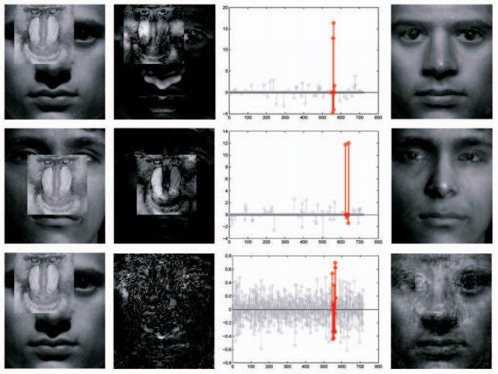
Face Recognition (2)

Slide 32
An important issue
When using sparse representation as a way of feature extraction, you may wonder, even if there exists the sparsity property in the data, does sparse feature really come up with better results? Does it contain any semantic meaning?
Successful areas:
Face recognition
Digit recognition
Object recognition (with carful design):
Ex. K-means → Sparse representation

Slide 33
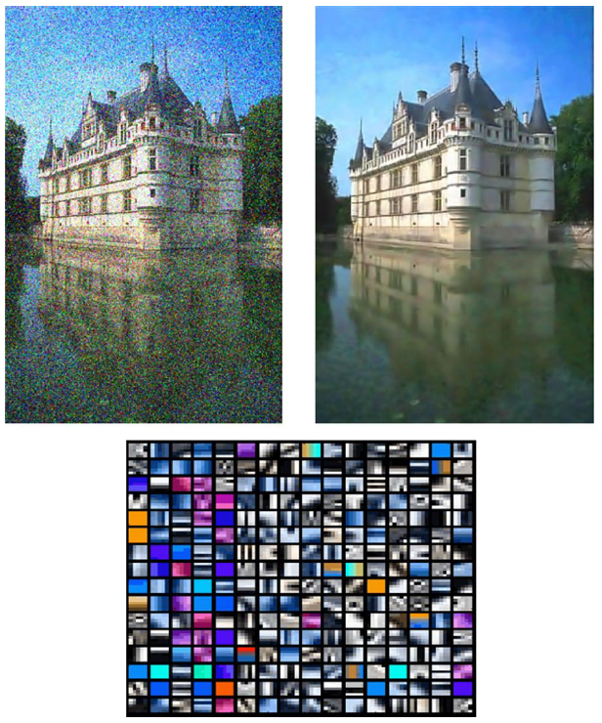
De-noising
Learn a patch dictionary.
For each patch, compute the sparse representation then use it to reconstruct the patch.

Slide 34
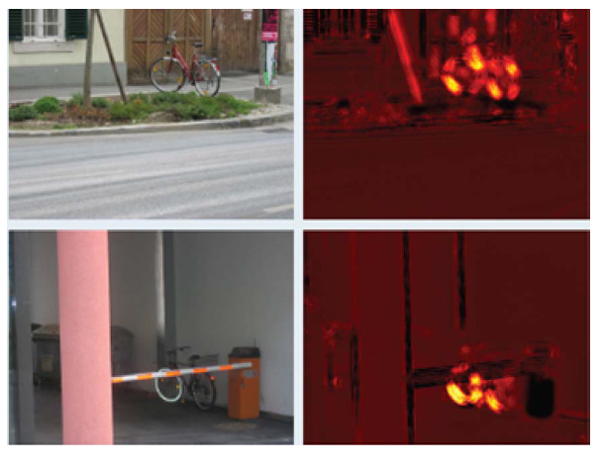
Detection based on reconstruction
Learn a patch dictionary for a specific object. For each patch in the image, compute the sparse representation and use it to reconstruct the image. Check the error for each patch, and identify those with small error as detected object.
Maybe not over-complete
Other cases: Foreground-background detection, pedestrian detection, ……

Slide 35
Conclusion

Slide 36
What you should know
What is the form of standard optimization?
What is sparsity?
What is sparse coding and sparse sensing?
What kind of optimization method to solve it?
Try to use it !!

Slide 37
Thank you for listening

